Slide 1
Factors That Affect Movie Revenue
Qiang Fang, Minji Lee, Katrina Truebenbach, Mingfei Zhou

Slide 2


Dataset – IMDB5000 Movie Dataset,
About the dataset: 28 columns (genre, gross, director_name, etc.)
Our goal from this dataset: Figure out which predictors are most effective to predict movies’ revenue
The most plausible variable seemed to be ‘genre’. We chose ‘revenue’ as response variable
We also added external data: The Academy Awards dataset and World Bank dataset

Slide 3

External Dataset- The Academy Awards
We thought ‘Oscar-winning actors/actresses/directors’ may be an indicator of successful movies.
Time period: 1927-2015
Basic data cleaning
Make sure to filter Oscar awards for actors, actresses, and director.
Issue: for the first few years, the dataset lists director name under ‘name’ for the directing awards, as is logical. However, it switches in 1930 such that ‘name’ is the film name and ‘film’ is the director name.
Drop unnecessary columns (ceremony, award, winner, film)
Cumulatively sum number of Oscars per actor/actress and director

Slide 4
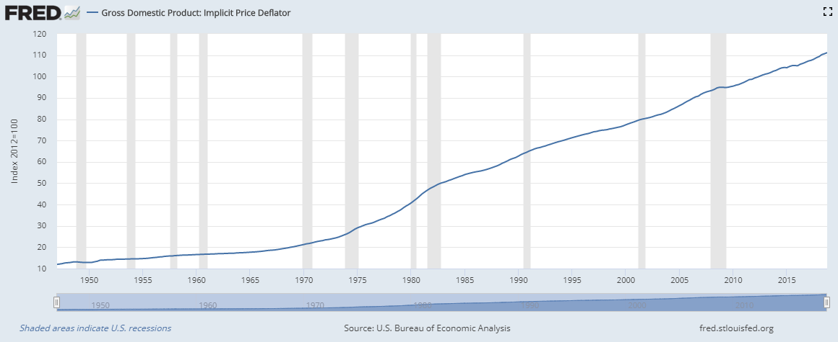
External Dataset- World Bank
As some of the movies are foreign movies, we thought we should consider
Basic cleaning: rename columns and create date variable
Deflator data is quarterly, but movie data is annual. Take average across quarters to get an annual deflator
Eventually we decided that some revenues were written as dollars and some are in foreign currency and there was no way to distinguish, we decided to not use this data anymore.

Slide 5
Merge Movie and Deflator Data by Year
Check if there are any non-matches
As deflator data starts at 1947, check how many data are before 1947. We see only 13 data in that time so we can drop that.
Convert nominal US dollars to real dollars
Real = nominal / GDPD (real_budget = budget/gdpd)
Merge Movie and Actor Oscar Data
Merge 4 times: once for each of the 3 actor columns in the movie dataset and once for director. Get the total number of scars for that person at the time of the movie release.
Add together the number of scars that the actors/actresses in that movie have earned.
In that report, need to acknowledge that this is not at all a good measure of actor popularity because many popular actors and actresses never win Oscars.
However, is academy in tune with what audience want to see and will pay for?
There are 2 movies with cumulative # actor Oscars == 4.
6 movies with 3.
25 movies with cumulative # actor Oscars ==2

Slide 6
Partition Data
Choosing 60% train because data itself is not big and we would like to keep valid and test are big enough.
Save data.

